Slide 1
Tourism website
Submitted To: Ghulam Muhi-u-Din (12-ARID-1963)

Slide 2
Introduction
In this website, we can facilitate the tourist that which places they should visit and where they can stay. We also provide the facility of traveling and gives some exciting offers and tickets and will provide complete visit of that places.

Slide 3
Tools:
Tools which we have used for making HTA (Hierarchal Task Analysis), Wireframes and interface designs:
1) Microsoft Word
2) Pencil
3) Notepad

Slide 4
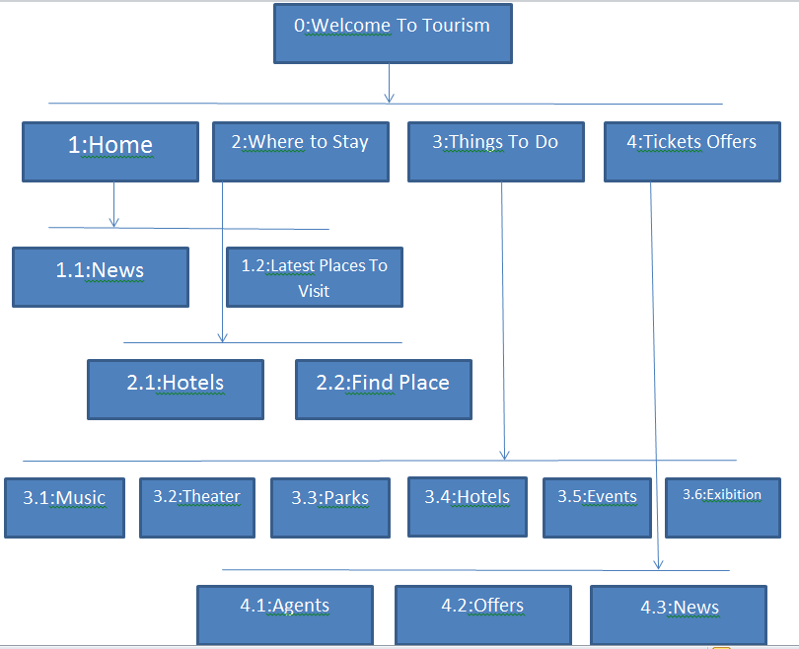
HTA

Slide 5
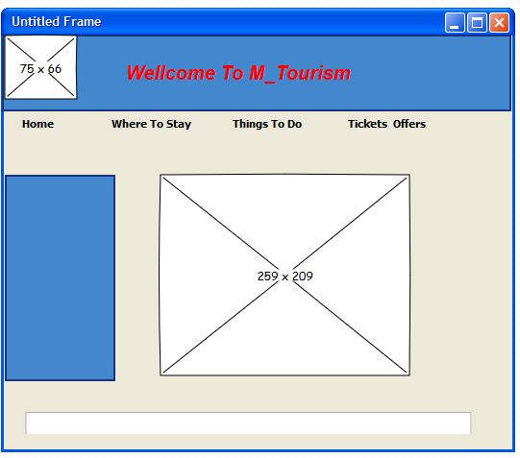
Wireframes

Slide 6
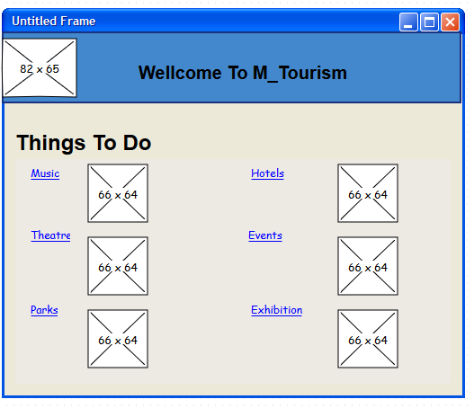
Wireframes

Slide 7
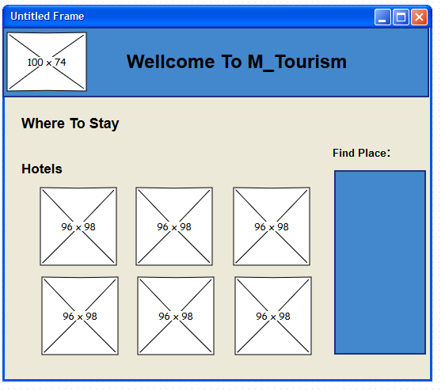
Wireframes

Slide 8
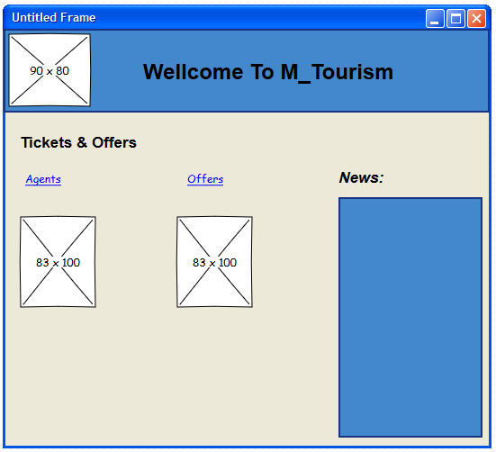
Wireframes

Slide 9
Advantages
Tourism generated income can be tremendously beneficial to the host country and it's local communities.
Tourism allows local people an opportunity for economic and educational growth that would not otherwise be available.
It allows both the tourist and the local community a chance to experience other cultures, which broadens understanding.

